Slide 1
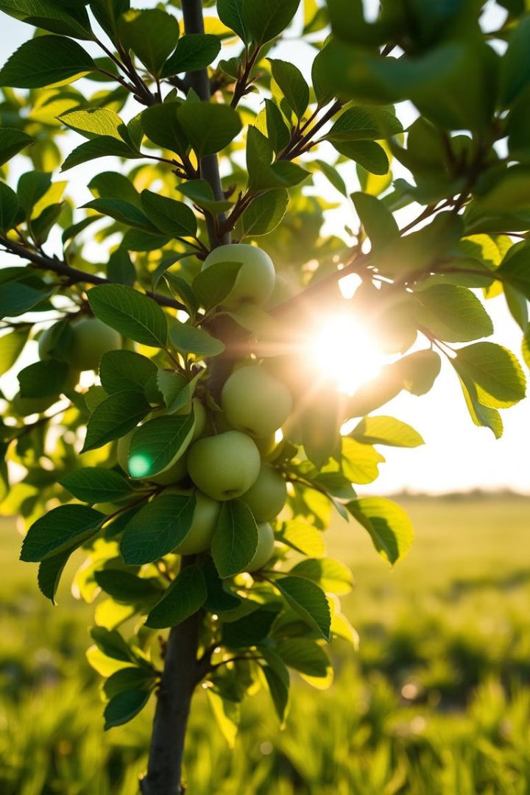
Plant Disease Detection: A Deep Learning Approach
This presentation explores our project, Plant Disease Detection, a Deep Learning model trained to identify diseases in apple trees. It leverages the power of Convolutional Neural Networks (CNNs) for image classification, offering a precise and efficient solution for early disease detection.

Slide 2

Project Overview
The Challenge
Our Solution
Detecting plant diseases early is crucial for preventing crop losses and ensuring agricultural productivity. Accurate identification allows timely intervention, preventing outbreaks and minimizing damage.
We utilize CNN image classification, a powerful technique for analyzing visual data. This approach enables the model to learn patterns and features from diseased apple images, leading to accurate disease identification.

Slide 3
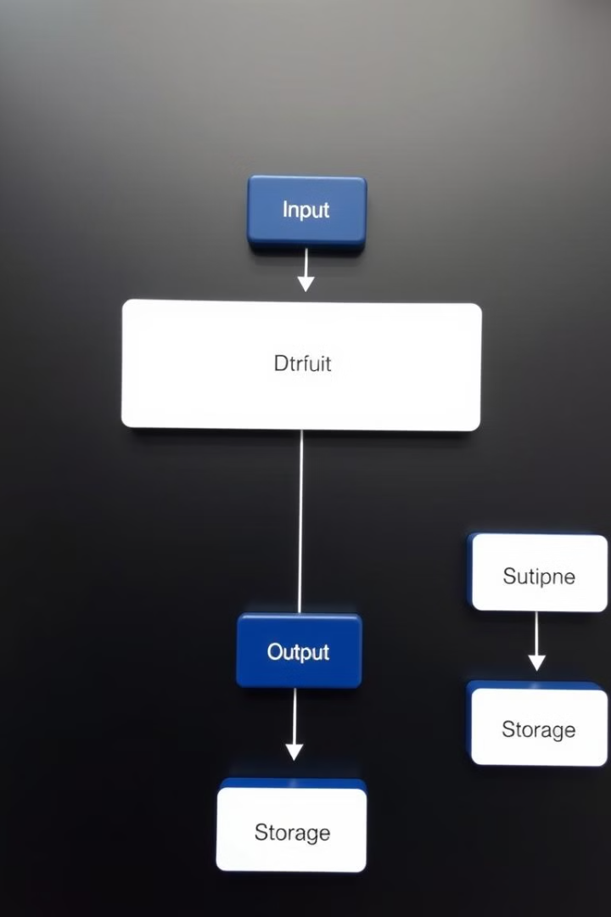
Project Structure and Modules
Preprocessing
Device Manager
The pre_processing.py module handles essential data preparation tasks. This includes loading and augmenting the dataset, then splitting it into training, validation, and test sets. Data normalization and transformations are applied to ensure optimal model performance.
The device_manager.py module manages device selection, intelligently utilizing either the CPU or GPU for faster computation and training. It efficiently transfers data and models to the selected device, maximizing resource utilization.
Training and Evaluation
The Training_evaluation.py module contains functions for training the CNN model (fit) and evaluating its performance (evaluate). Training involves iteratively feeding the model with data, while evaluation measures its accuracy and loss on validation data.

Slide 4
Key Functions: Preprocessing and CNN Model
Preprocessing (pre_processing)
CNN Model (CnnModel)
This function serves as the foundation for preparing the dataset for training. It loads images, splits the dataset, and applies transformations such as resizing and normalization, enhancing the model's ability to learn meaningful patterns from the data.
The CNN model is designed specifically for image classification. Its architecture comprises convolutional layers, pooling layers, activation functions, and fully connected layers, working together to extract relevant features from the image data and make accurate predictions.

Slide 5
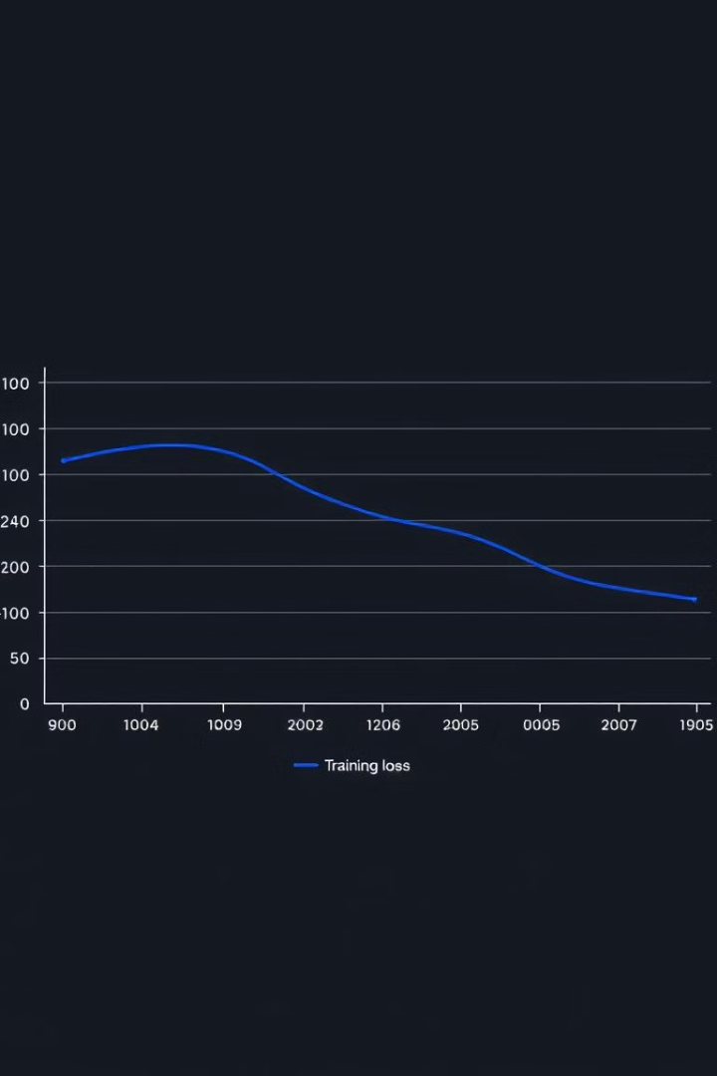
Training, Evaluation, and Visualization
1
Training
2
Evaluation
The fit function trains the CNN model by iteratively feeding it with training data and adjusting its parameters to minimize the error. This process involves calculating the loss, updating the model's weights, and optimizing its performance.
The evaluate function assesses the model's performance on validation data. It measures the accuracy and loss of the model, providing valuable insights into its ability to generalize to unseen data.
3
Visualization
The plot_accuracies , plot_losses and plot_confusion_matrix
functions visualize the training and validation metrics, allowing for easy analysis of the model's performance over time.

Slide 6
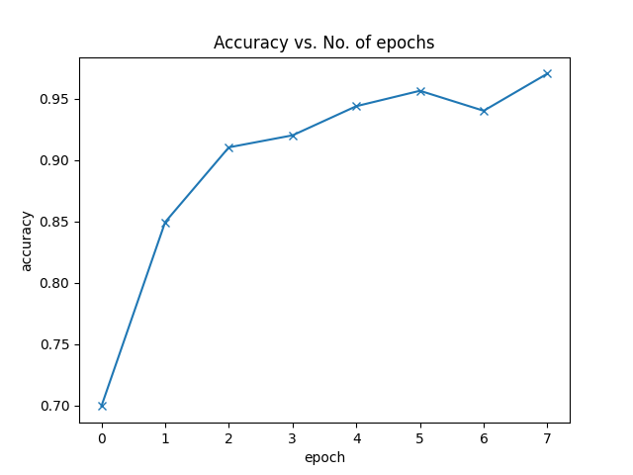
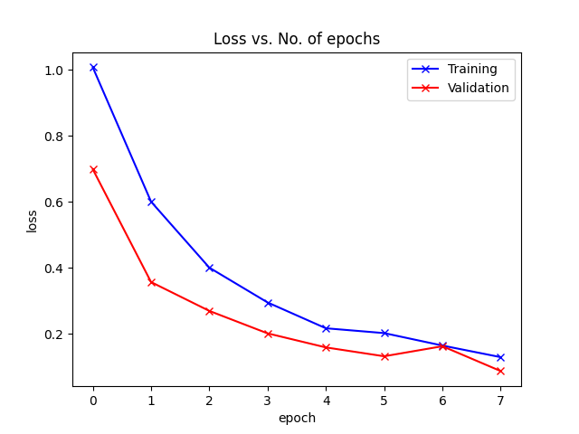
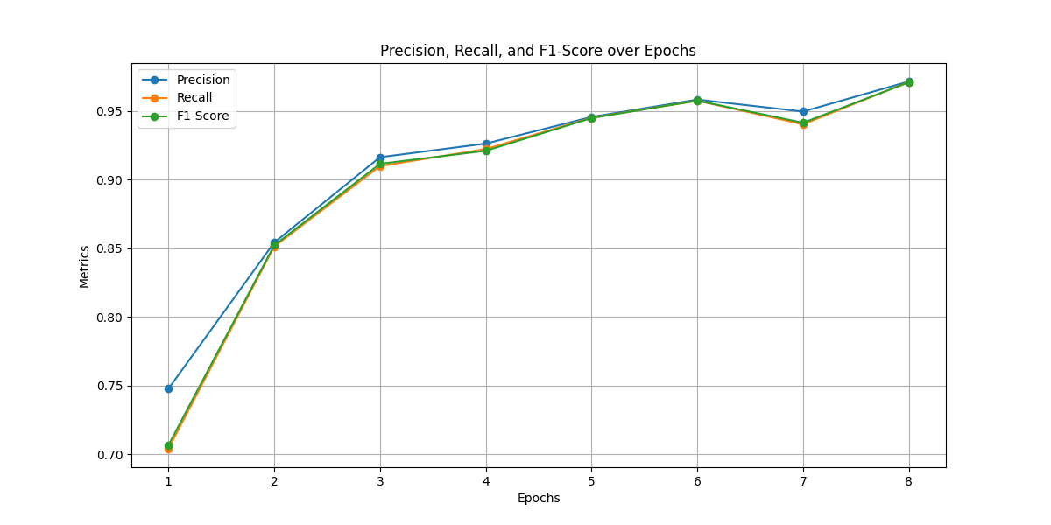
3
Visualization

Slide 7
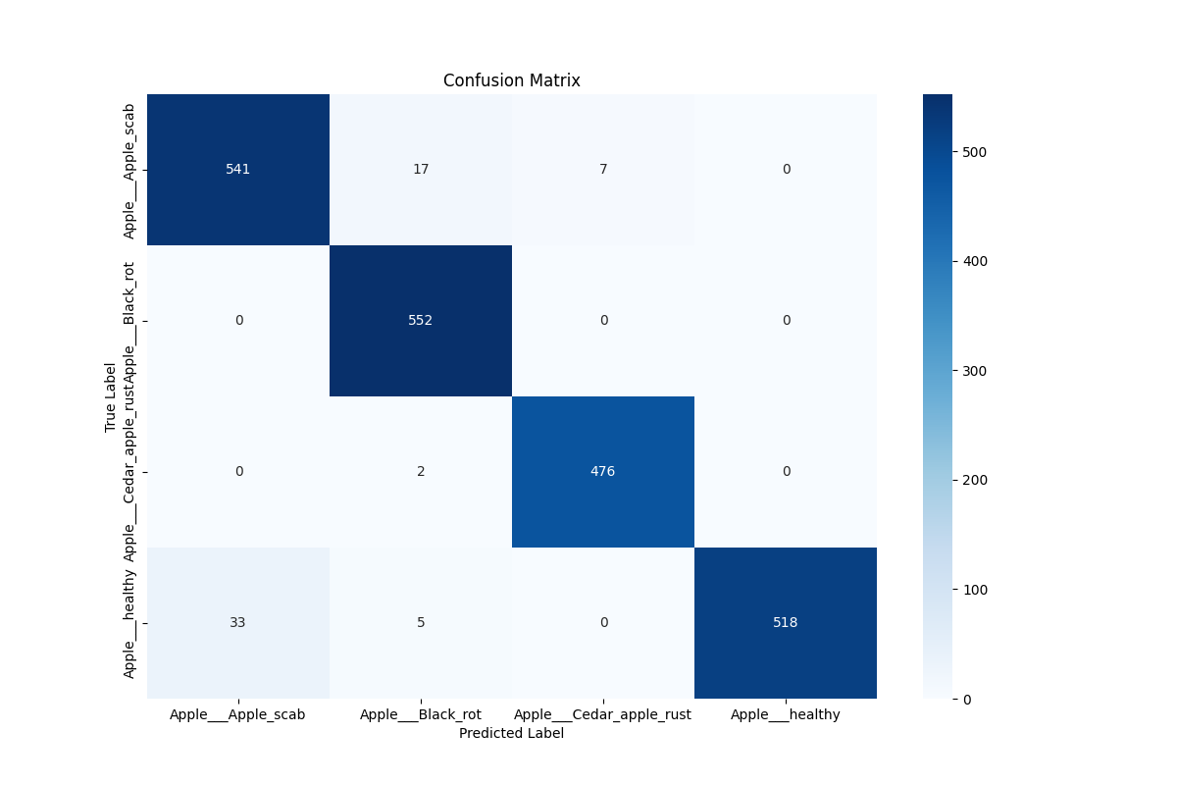
Confusion Matrix

Slide 8
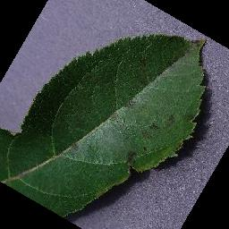
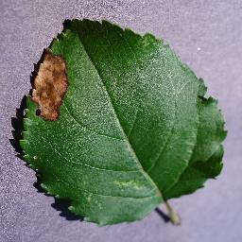
Model Prediction
1
Apple scab
2
Black Rot

Slide 9
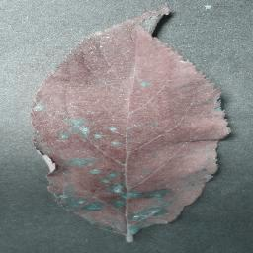
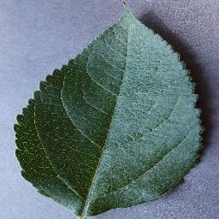
3
Cedar Apple Rust
4
Apple Healthy

Slide 10
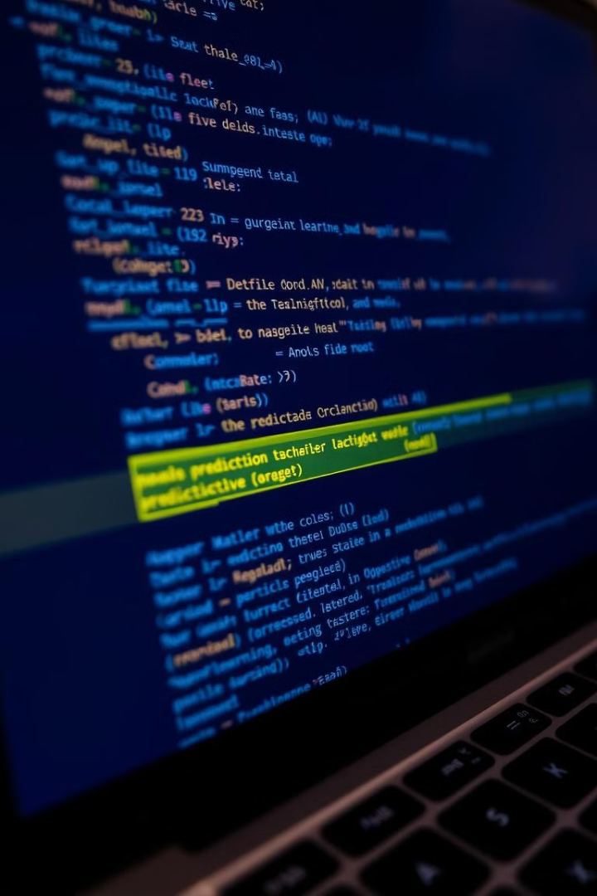



Testing and Model Deployment
Prediction
Evaluation
The predict_image function takes a new image as input and uses the trained model to classify it, predicting the type of disease present. This enables real-time detection and diagnosis of plant diseases.
The evaluate_test function assesses the model's performance on the test dataset, providing a final evaluation of its accuracy and generalization capability on unseen data.
Model Saving
Once the training is complete, the model's parameters are saved to a file (modelAppleFile1.pth). This allows for easy deployment and reuse of the model in future applications.

Slide 11
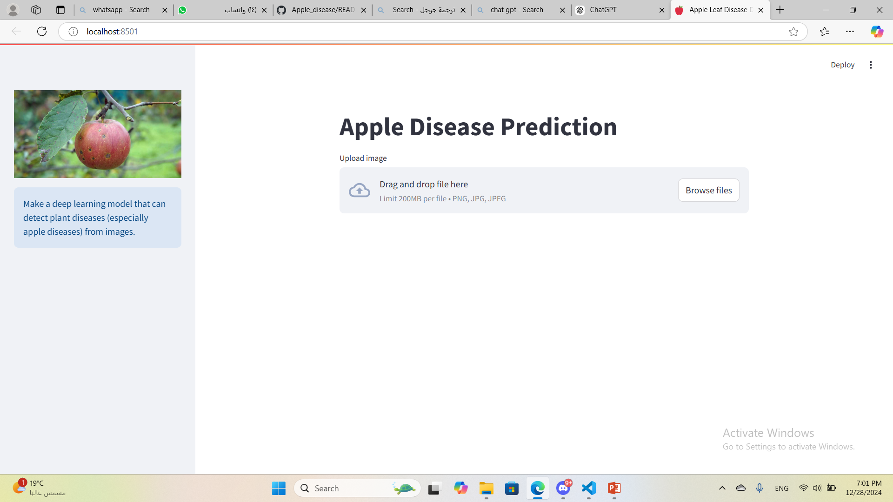
Deployment :
(Before Uploade Image)

Slide 12
Deployment :
Using Streamlit
1
Main Page :
1- Show a place to upload the image
2- Show an X to place another image
3- Show the image after uploading
4- Show each of: Predicted Disease, Disease Description, treatment and precautions.
5- Training and Validation Visualizations: a place to display one of the measurements

Slide 13
Deployment :
2
Side Bar :
1- Display an illustrative image of the project
2- View Test Loss and Test Accuracy in case of category prediction
3- Choose a Visualization: If you want to display a scale of the model in a well-groomed manner
Note
When an apple expects it to be healthy, balloons appear celebrating that it is healthy

Slide 14
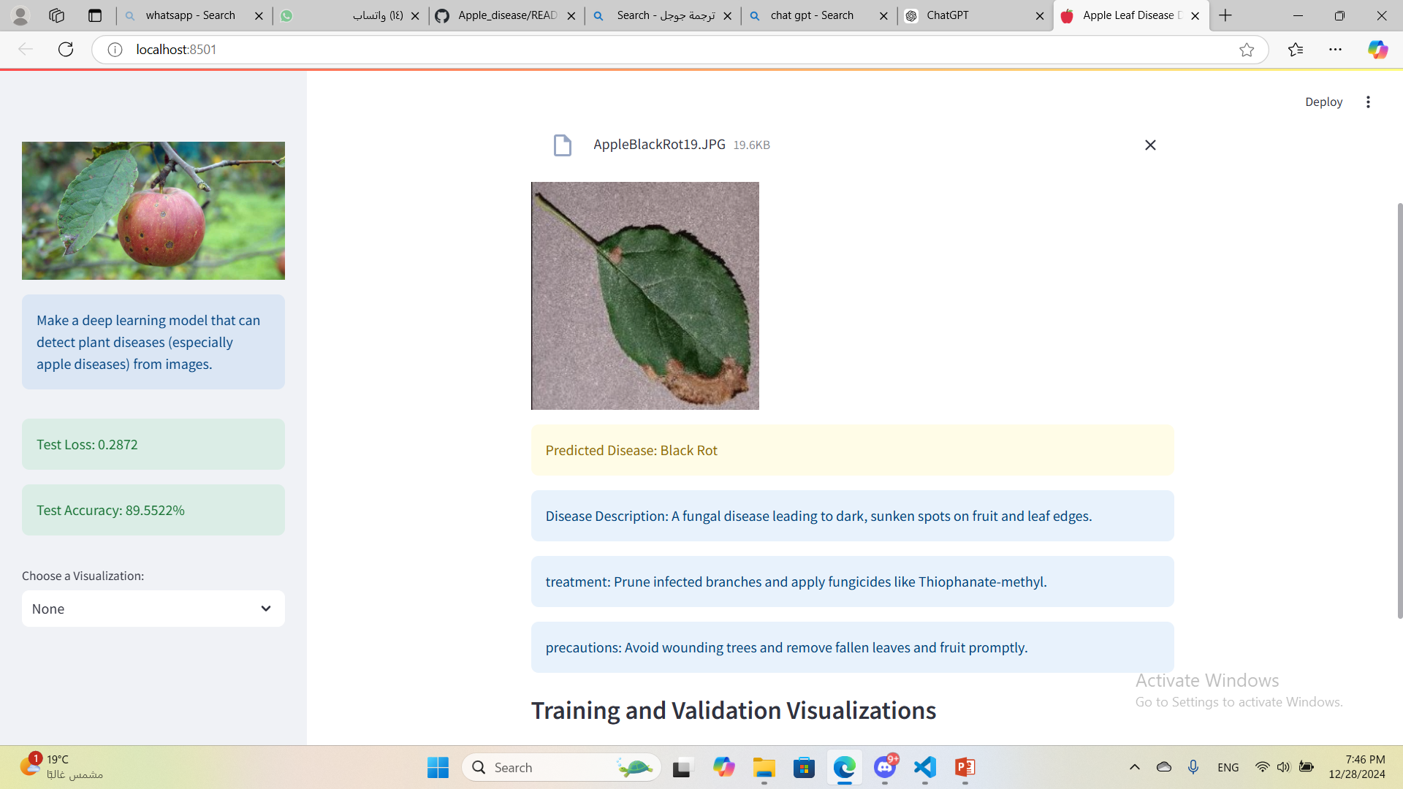
Deployment :
(After Upload Image)

Slide 15
Workflow and Key Parameters
Preprocessing
1
The data preparation steps, including loading, splitting, and augmentation, are crucial for setting the foundation for successful training and model performance.
2
Model Creation
The CNN model is defined and initialized, setting the architecture for feature extraction and classification of diseased apple images.
Training
3
The training process involves iterative learning from the training data, adjusting model parameters to minimize errors and improve accuracy.
4
Validation
The model's performance is evaluated on the validation dataset, measuring its ability to generalize to unseen data.
Testing
5
The final evaluation occurs on the test dataset, providing a comprehensive assessment of the model's accuracy and readiness for deployment.
6
Deployment
The trained model is saved and deployed for use in real-world applications, enabling accurate and efficient plant disease detection.

Slide 16
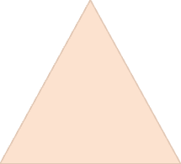



Running the Project
Prerequisites
1
Install necessary libraries (torch, torchvision, etc.)
Dataset
2
Ensure the dataset is organized correctly in the specified data directory.
Execution
3
Run the script (python main.py) to initiate the training and evaluation processes.
Results
4
Examine the output files and plots, including the saved model parameters and performance metrics.

Slide 17
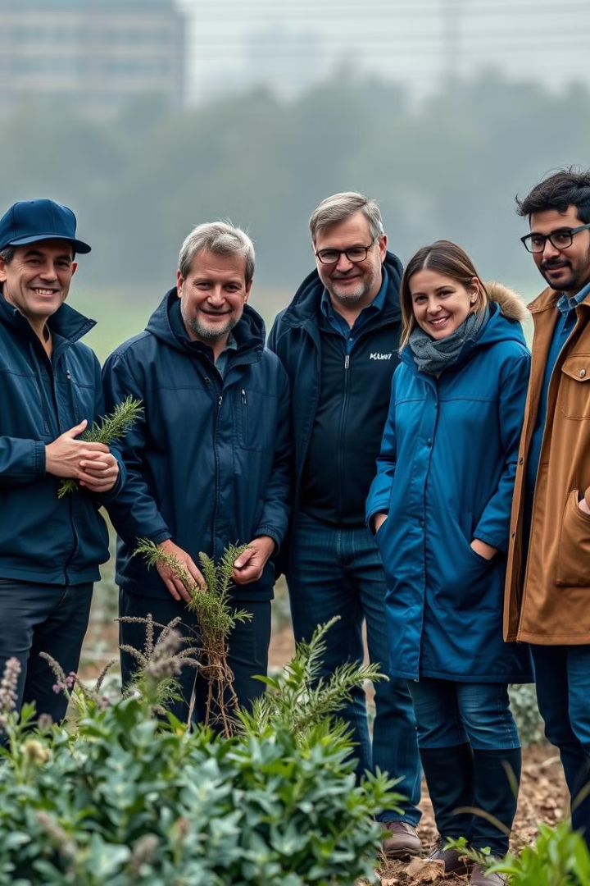
Thank You
Thank you for your time and attention. We believe this project holds significant potential for advancing plant disease detection and improving agricultural practices. We look forward to continued research and collaboration in this critical area.

